Slide 1
Pisky-Nagy Ádám
Demo,
The First

Slide 2
Who am I/How did I get here? (excerpt)
Me:
Local guy
ELTE, geographer
Project manager (EU)
Field inspector
Football referee
Free-time cook
How:
Uninspiring job and job environment
Depression
Creative famine

Slide 3
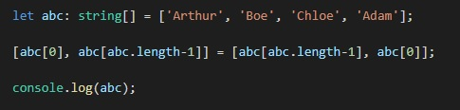

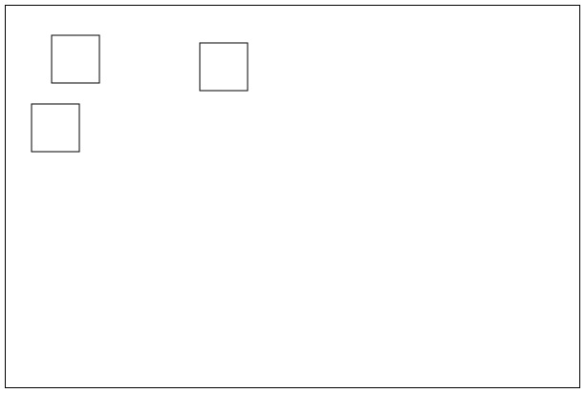

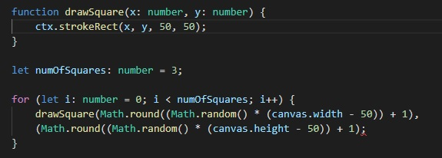
What I learnt so far?
What you did…
Switching array elements easily

Slide 4
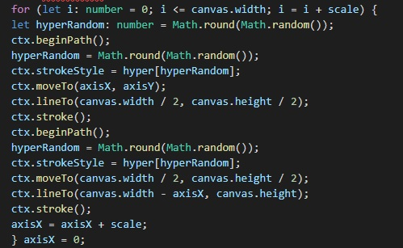
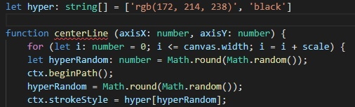

Favourite toy (…so far)
RGB-based color randomizer
Math.random = between 0 and 1
If used in a loop -> insert inside it
Can be used to call array elements

Slide 5

Thank you for your attention!

